Slide 1
Lecture - 17
Chapter 10
IMAGE SEGMENTATION

Slide 2
Marr-Hildreth Edge Detector
LoG (Laplacian of Gaussian) Operator
⎛ x + y ⎞
( )
2
2
G x, y = exp −
⎜
2σ²
⎟
⎝ ⎠
∇2
∂²G (x, y ) ∂²G (x, y )
G (x, y )=
+
∂x² ∂y²
∇² G (x, y )= ^{⎡ x2}
− ^{1 ⎤} G (x, y )+ ^{⎡ y2} − ^{1 ⎤} G (x, y )
⎢
⎥ ⎢
⎥
⎣
⎡
σ σ
σ σ
4
2
⎦
⎣
4
2
⎦
x + y − 2σ
⎤
( )
2 2
2
( )
∇ G x, y =
G x, y
2
⎢
_{σ} 4
⎥
⎣
⎦
⎡ r ² − 2σ ² ⎤
⎛
_{r}2
⎞
∇2
G (x, y )=
exp −
⎢
_{σ}4
⎥
⎜
2σ
2
⎟
⎣
⎦ ⎝
⎠

Slide 3
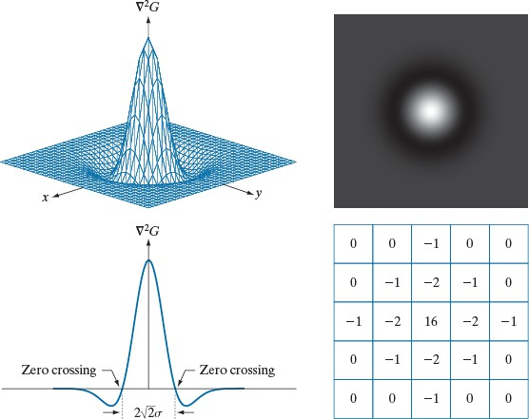
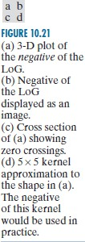
Marr-Hildreth Edge Detector
LoG (Laplacian of Gaussian) Operator

Slide 4
Marr-Hildreth Edge Detector
LoG (Laplacian of Gaussian) Operator
Idea:
Smoothing
Sharpening
g (x, y )= ⎡ ⎣∇²G(x, y )⎤⎦ f (x, y )= ∇² ⎡⎣G(x, y )
Algorithm:
Compute Laplacian of Gaussian filtered
Find zero-crossing
Use a 3×3 window around each pixel
ZC occurs if at least two opposing neighbors has different signs.

Slide 5
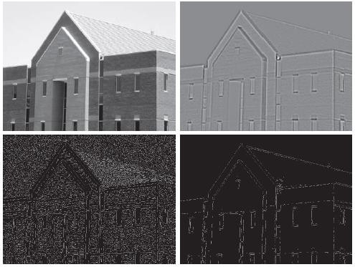
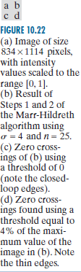
Marr-Hildreth Edge Detector
LoG (Laplacian of Gaussian) Operator

Slide 6
Marr-Hildreth Edge Detector
LoG = Difference of Gaussian (DoG)
LoG Approximation with DoG:
– DoG: Difference of Gaussian:
1 ⎛
_{x}2
+ y² ⎞ 1
⎛
_{x}2
+ y² ⎞
DoG (x, y )=
⎟ , σ >σ
exp⎜ −
⎟ −
exp⎜ −
2
2
2
2πσ
2
2σ 2πσ
2
2σ
1
2
2
2 ⎠
⎝ 1 ⎠ ⎝
1
2
Ratio of 1.6:1, an engineering approximation of LoG.
For same zero-crossing:
σσ² ⎡σ ²
⎤
σ =
2
2
1 2
ln
⎢
1
⎥
σ
2
−σ
σ
2
2
2 ⎣ 2 ⎦
1

Slide 7
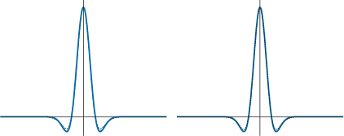
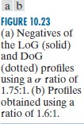
Marr-Hildreth Edge Detector
LoG (Laplacian of Gaussian) Operator

Slide 8
Canny Edge Detector
Canny Edge Detector Steps:
Smoothing
Compute Gradients
Non-maximum Suppression
Edge Tracking by hysteresis (double ) thresholding

Slide 9

Canny Edge Detector
Canny – Smoothing:
– Using Gaussian filter:
f _{s} (x , y )= G (x , y )
f (x , y )
⎛ x + y ⎞
( )
2
2
, σ= 1.4
G x , y = exp −
⎜
2σ²
⎟
⎝
⎠
– Practical Implementation:
⎡2
⎢₄
4 | 5 | 4 | 2⎤
9 | 12 | 9 | ₄⎥ ⎥
1
⎢
G (x , y )=
⎢5 12 15 12
9 12 9
4 5 4
5⎥
159 ⎢₄
₄⎥
⎢
⎣2
⎥
2⎥⎦

Slide 10

Canny Edge Detector
Canny – Gradient:
Using any gradient kernel:
g_{x} (x , y )= w _{x} (x , y ) f _{s} (x , y )
g _{y} (x , y )= w _{y} (x , y ) f _{s} (x , y )
Practical Implementation:
Sobel Kernel
⎡−1 0 +1⎤
w _{x} (x , y )= ⎢−2 0
⎢ ⎥
⎢⎣−1 0 +1⎥⎦
⎡−1 −2 −1⎤
w _{y} (x , y )= ⎢ 0 0
₀ ⎥
+2⎥,
⎥
⎢⎣+1 +2 +1⎦⎥
⎢

Slide 11
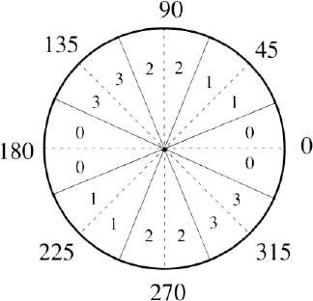
Canny Edge Detector
Canny - Non-maximum Suppression (1):
– Compute magnitude and angle of gradient:
M (x, y )=
g ² + g ² ≈ g + g
x y
x
y
( )
⎛ g ⎞
θ x, y = tan
−1
y
⎜ _{g} ⎟
⎝ x ⎠
– Quantize the θ(x,y) to nearest 45°, θ_{Q} (x,y)

Slide 12
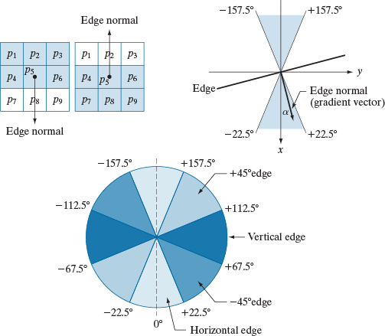
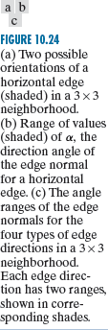
Canny Edge Detector
Canny - Non-maximum Suppression (2)
- Quantization

Slide 13
Canny Edge Detector
Canny - Non-maximum Suppression (3)
Quantization
Compare M (x,y) with M (x´,y´) in positive and negative gradient direction.
If greater than both then keep it, g_{N} (x,y)=M(x,y) else suppress it, g_{N} (x,y)=0
If θ_{Q} (x,y) = 0°◦, then the pixels (x+1, y), (x, y), and (x−1, y) are examined.
If θ_{Q} (x,y) = 90°◦, then the pixels (x, y+1), (x, y), and (x, y−1) are examined.
If θ_{Q} (x,y) = 45°, then the pixels (x+1, y+1), (x, y), and (x−1, y−1) are examined.
If θ_{Q} (x,y) = 135°◦, then the pixels (x+1, y-1), (x, y), and (x−1, y+1) are examined.

Slide 14
Canny Edge Detector
Canny – Edge Tracking (1):
Select two threshold (T_{H}, T_{L}), T_{H} = kT_{L}
Form two images using two threshold:
⎧1 g _{N} (x , y )≥ T_{H}
⎩0 g _{N} (x , y )< T_{H}
⎧1 g _{N} (x , y )≥ T_{L}
⎩0 g _{N} (x , y )< T_{L}
(x , y )= ⎨
Fewer and Strong Edge
^{g} NH
g _{NL} (x , y )= ⎨
More and Weak/Strong Edge
– Eliminate strong edge from g_{NH}
g _{NL} (x , y )= g _{NL} (x , y )− g _{NH} (x , y )

Slide 15
Canny Edge Detector
Canny – Edge Tracking (2):
All strong edge in g_{NH} are store and marked immediately.
Gaps in g_{NH} with fill using g_{NL}
Locate the next unvisited pixel, p, in g_{NH} (x,y)
Mark as valid edge all weak pixels in g_{NL} (x,y) that are
connected to p, using N8 criteria.
If all nonzero pixel in g_{NH} (x,y) has been visited go to step #4 else go to step #1
Set to zero all pixels in g_{NL} (x,y) that were not marked as
valid edge.
Append g_{NH} (x,y) and nonzero elements of g_{NL} (x,y)

Slide 16
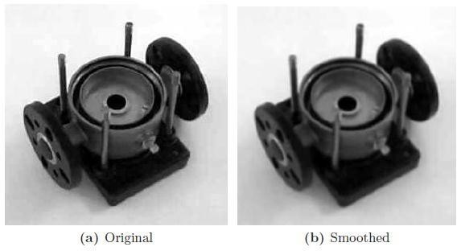
Canny Edge Detector
Canny Example (1):
– Original and Smoothed

Slide 17
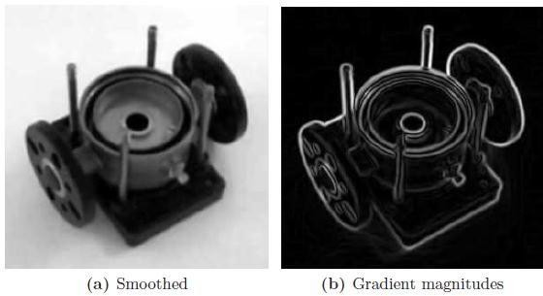
Canny Edge Detector
Canny Example (1):
– Gradient Image

Slide 18
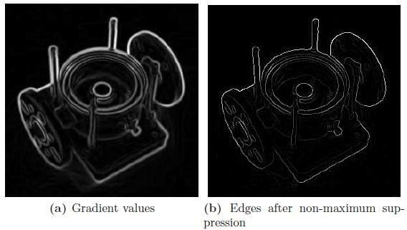
Canny Edge Detector
Canny Example (1):
– Non-maximum Suppression

Slide 19
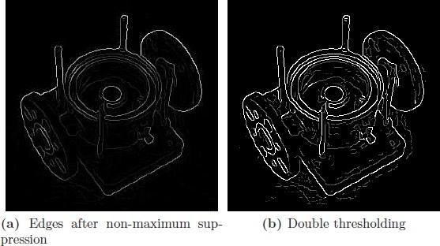
Canny Edge Detector
Canny Example (1):
– Double Thresholding

Slide 20
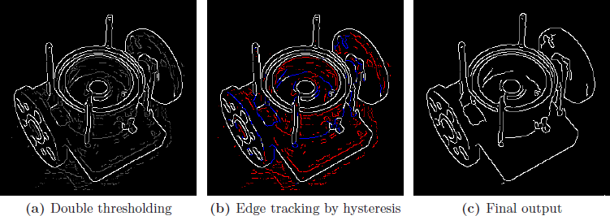
Canny Edge Detector
Canny Example (1):
– Edge Tracking

Slide 21
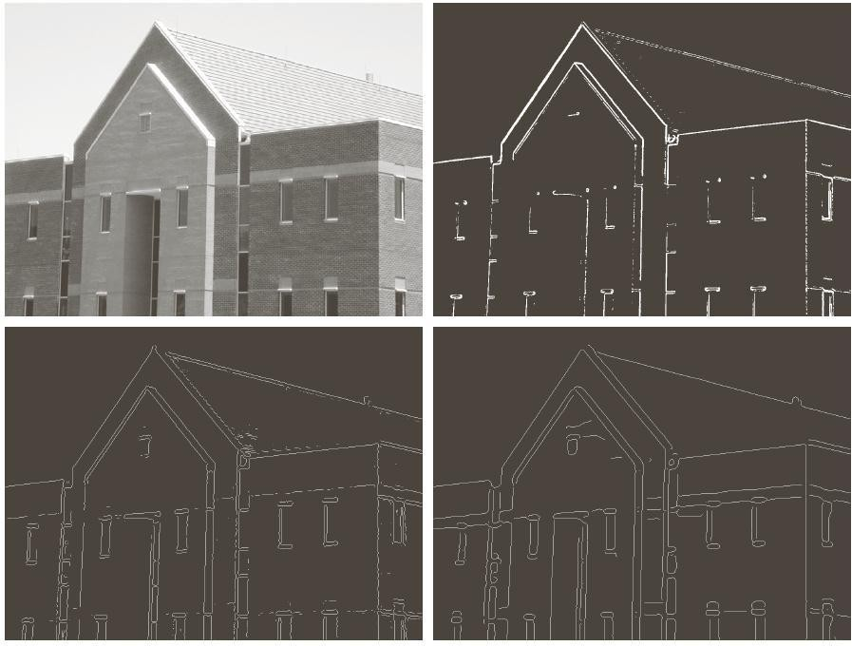
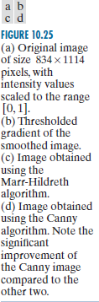
Canny Edge Detector
Canny Example (2):

Slide 22
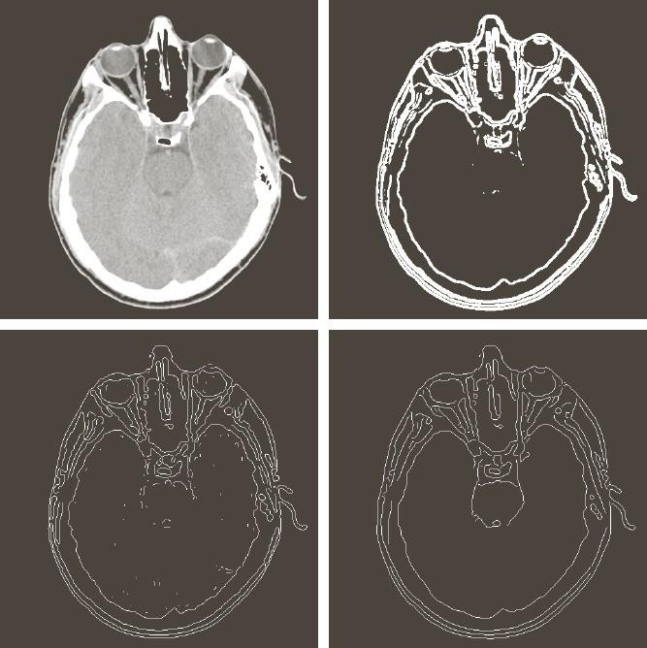
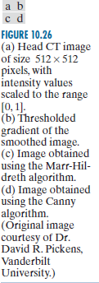
Canny Edge Detector
Canny Example (3):

Slide 23
Edge Linking
Edge Linking (Local Processing):
Similarity of two edge pixels at (x,y) and (s,t):
M (s,t )− M (x, y ) ≤ E and α (s,t )−α(x, y ) ≤ A
Connect if both condition satisfied
Computational Expensive

Slide 24
Edge Linking
Edge Linking (Local Processing):
A simple algorithm:
Compute M(x,y) and α(x,y) for input image.
Form a binary image g(x,y):
M (x, y )> T_{M} α(x, y )= A ± T_{A}
otherwise
⎧1
and
g (x, y )= ⎨₀
⎩
T_{M} : Threshold, A: Specified angle direction, ±T_{A}:acceptable direction margin
Scan rows of g and fill (set to 1) all gap (0’s) that do not exceed a
specified length, K.
Detect gaps in any direction, θ, by rotation the g by θ, and apply the horizontal scanning scheme. Rotate the result back to -θ

Slide 25
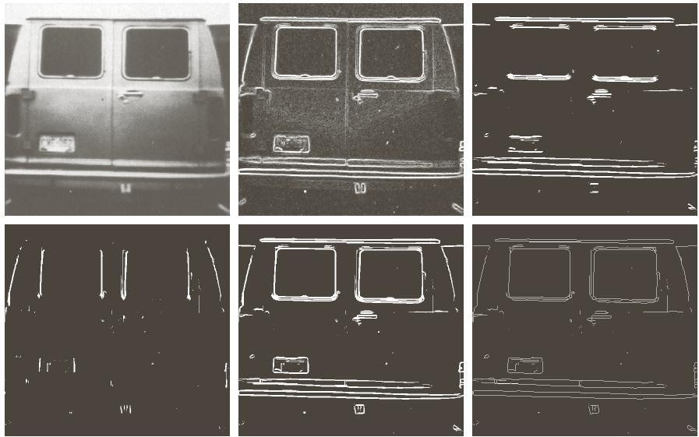
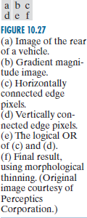
Edge Linking

